Slide 1



EDUWORK
Free Class Web Programming
www.eduwork.id

Slide 2
JQuery
Present by Eduwork.id
www.eduwork.id

Slide 3


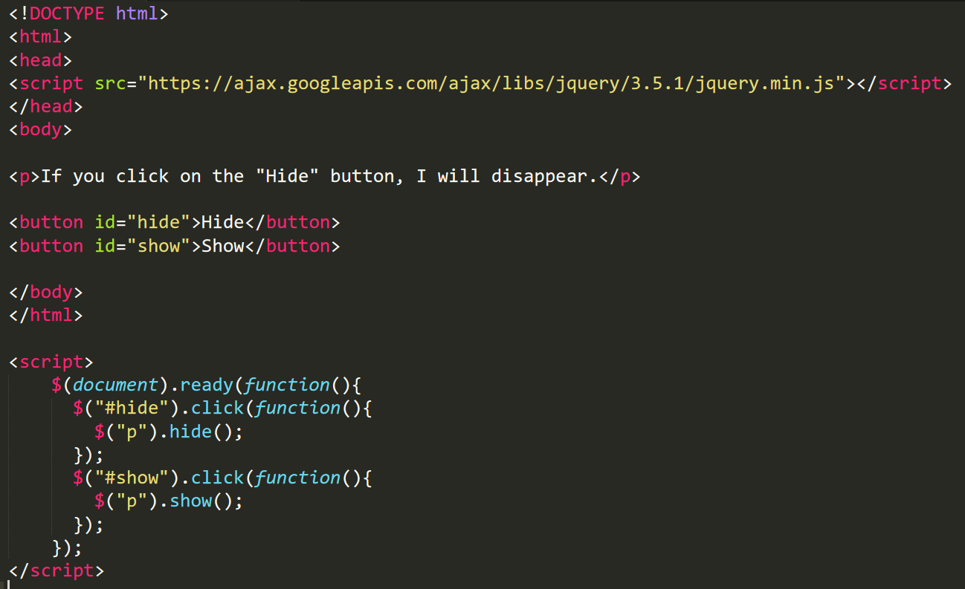
www.eduwork.id | Page 01
Elemen HTML

Slide 4
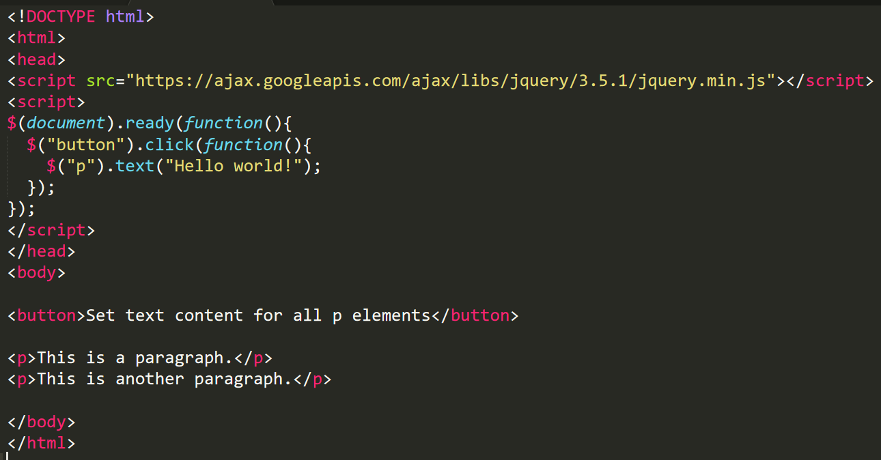
www.eduwork.id | Page 01
Elemen HTML

Slide 5
www.eduwork.id | Page 01
Latihan Studi Kasus (1)
Membuat form inputan dengan kondisi button disable apabila form masih belum diisi

Slide 6
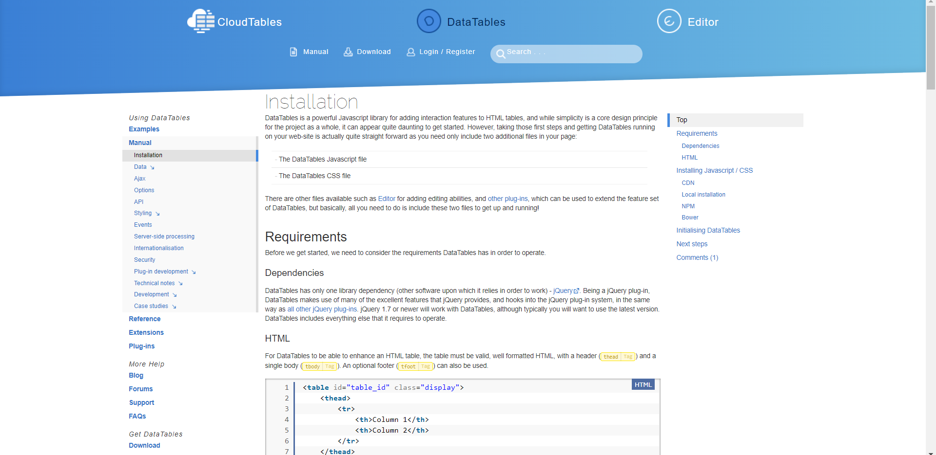
www.eduwork.id | Page 01
Latihan Studi Kasus (2)
https://datatables.net/manual/installation

Slide 7
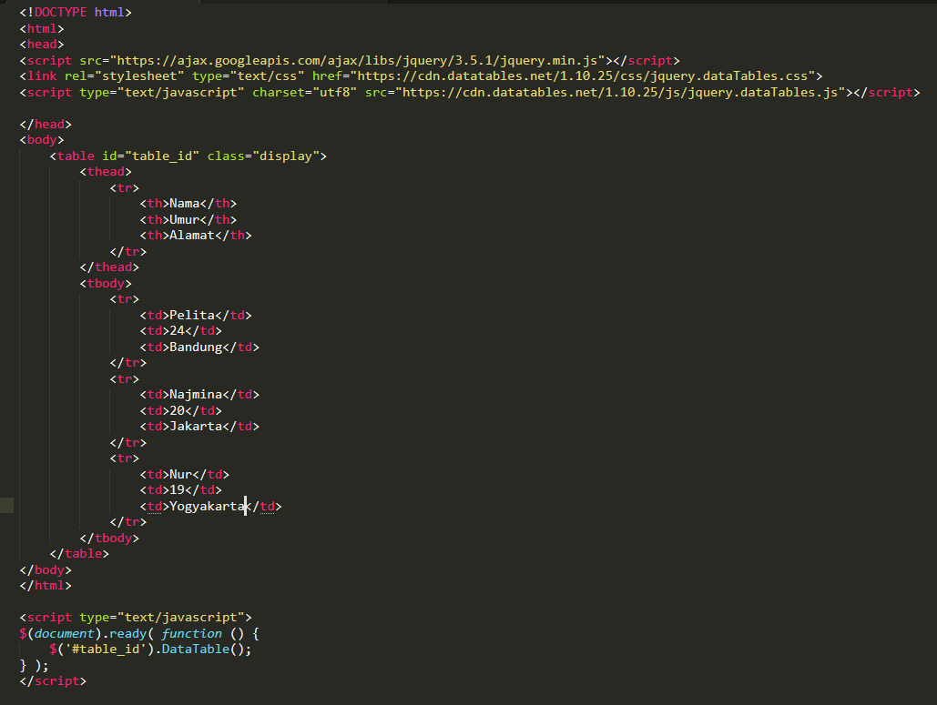
www.eduwork.id | Page 01

Slide 8
TUGAS JQuery
Present by Eduwork.id
www.eduwork.id

Slide 9
www.eduwork.id | Page 01
Tugas
Buatlah 2 datatable
Beri nama file tugas_datatable.html
Simpan ke dalam folder tugas_jquery

